Slide 1


AHMED ELGEIDI

Slide 2
PROBLEMATIC
Tools to add new devices to Proteus.

Slide 3
WAYS TO ADD A NEW PROTEUS COMPONENT
There are two ways to add a new Proteus component:
1. Create a component from scratch using electronic devices.
2. Use the VSM library (C++ project).

Slide 4
CREATING A NEW DEVICE FROM SCRATCH

Slide 5
To create a new component we have to follow these steps
1: Have the datesheet of the device
2 : create package for thedevice
3 :create it’s isis schematic for the device
4: create a simulation model

Slide 6
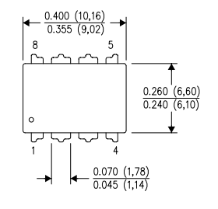
EXAMPLE OF A TIMER 555 CREATION
Here is the link of the component data sheet: https://www.ti.com/lit/ds/symlink/lm555.pdfts
In the firs sep we will create this footprint (dil package) using proteus pcb tools . To create it we have to follow the next steps .

Slide 7
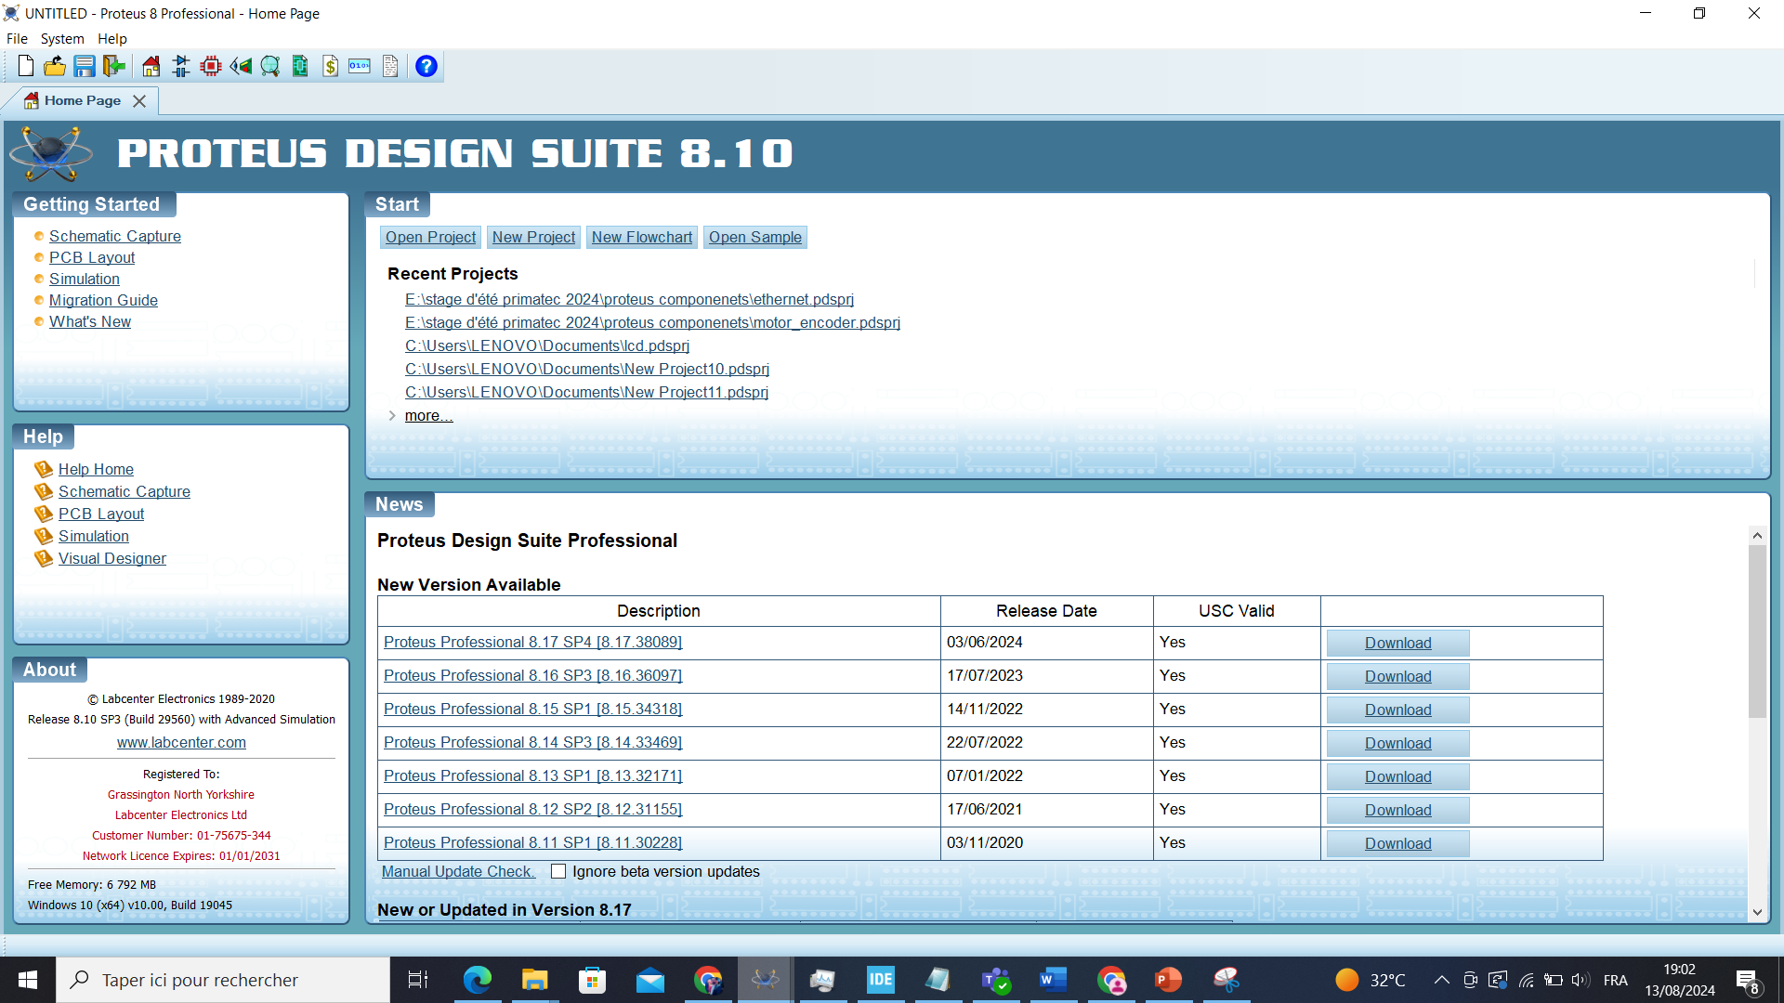



Slide 8
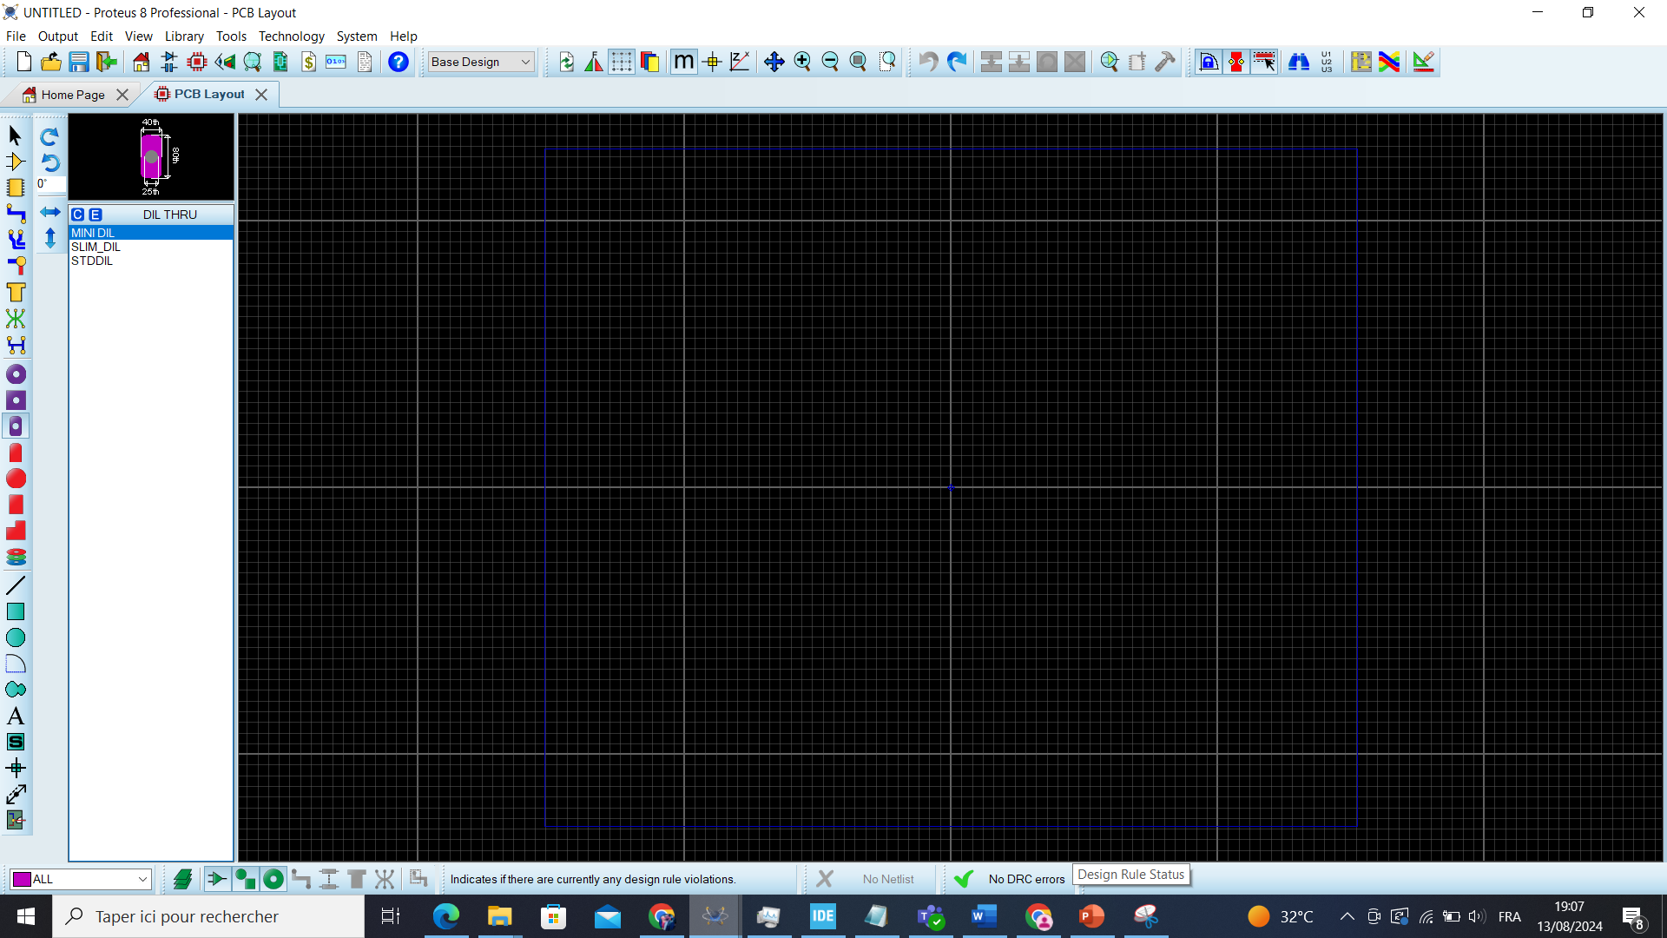



Slide 9
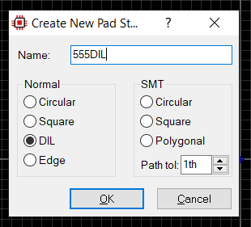
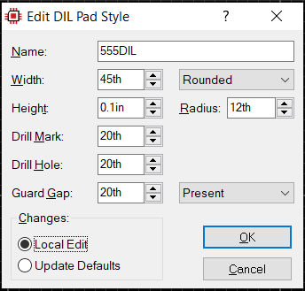
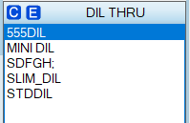
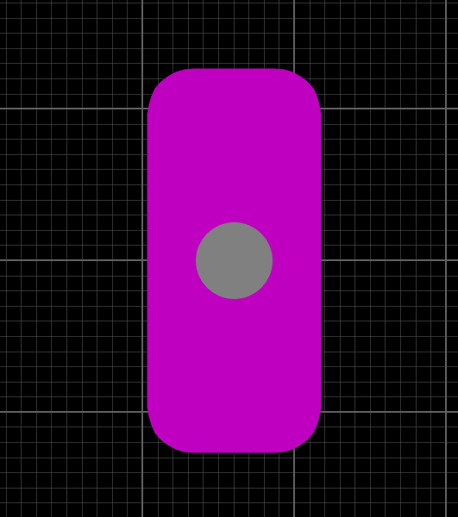

Slide 10
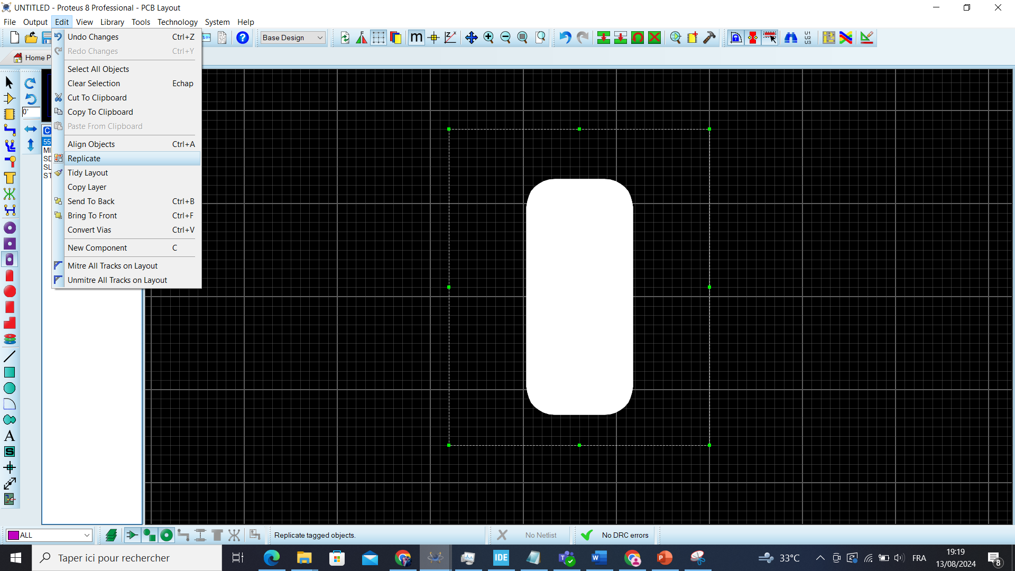


Slide 11
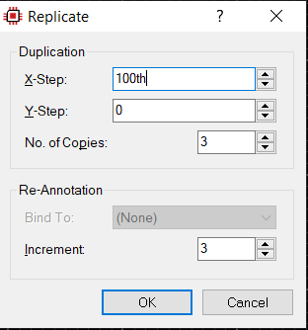
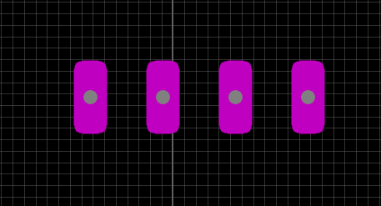


Slide 12
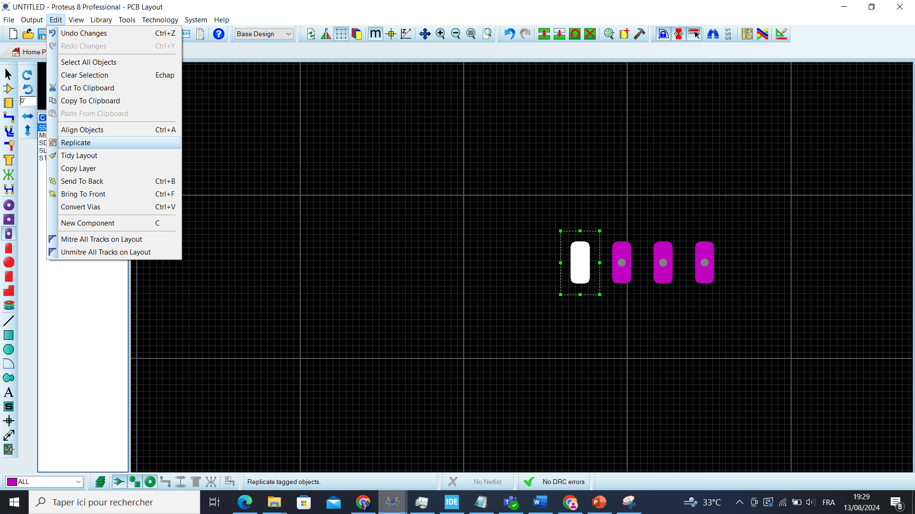

Slide 13
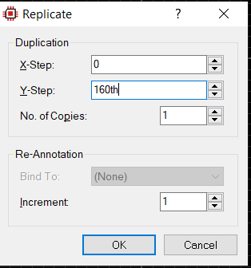
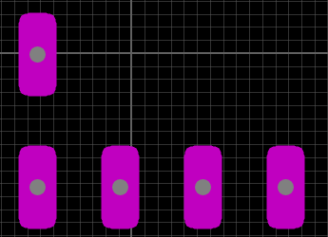

Slide 14
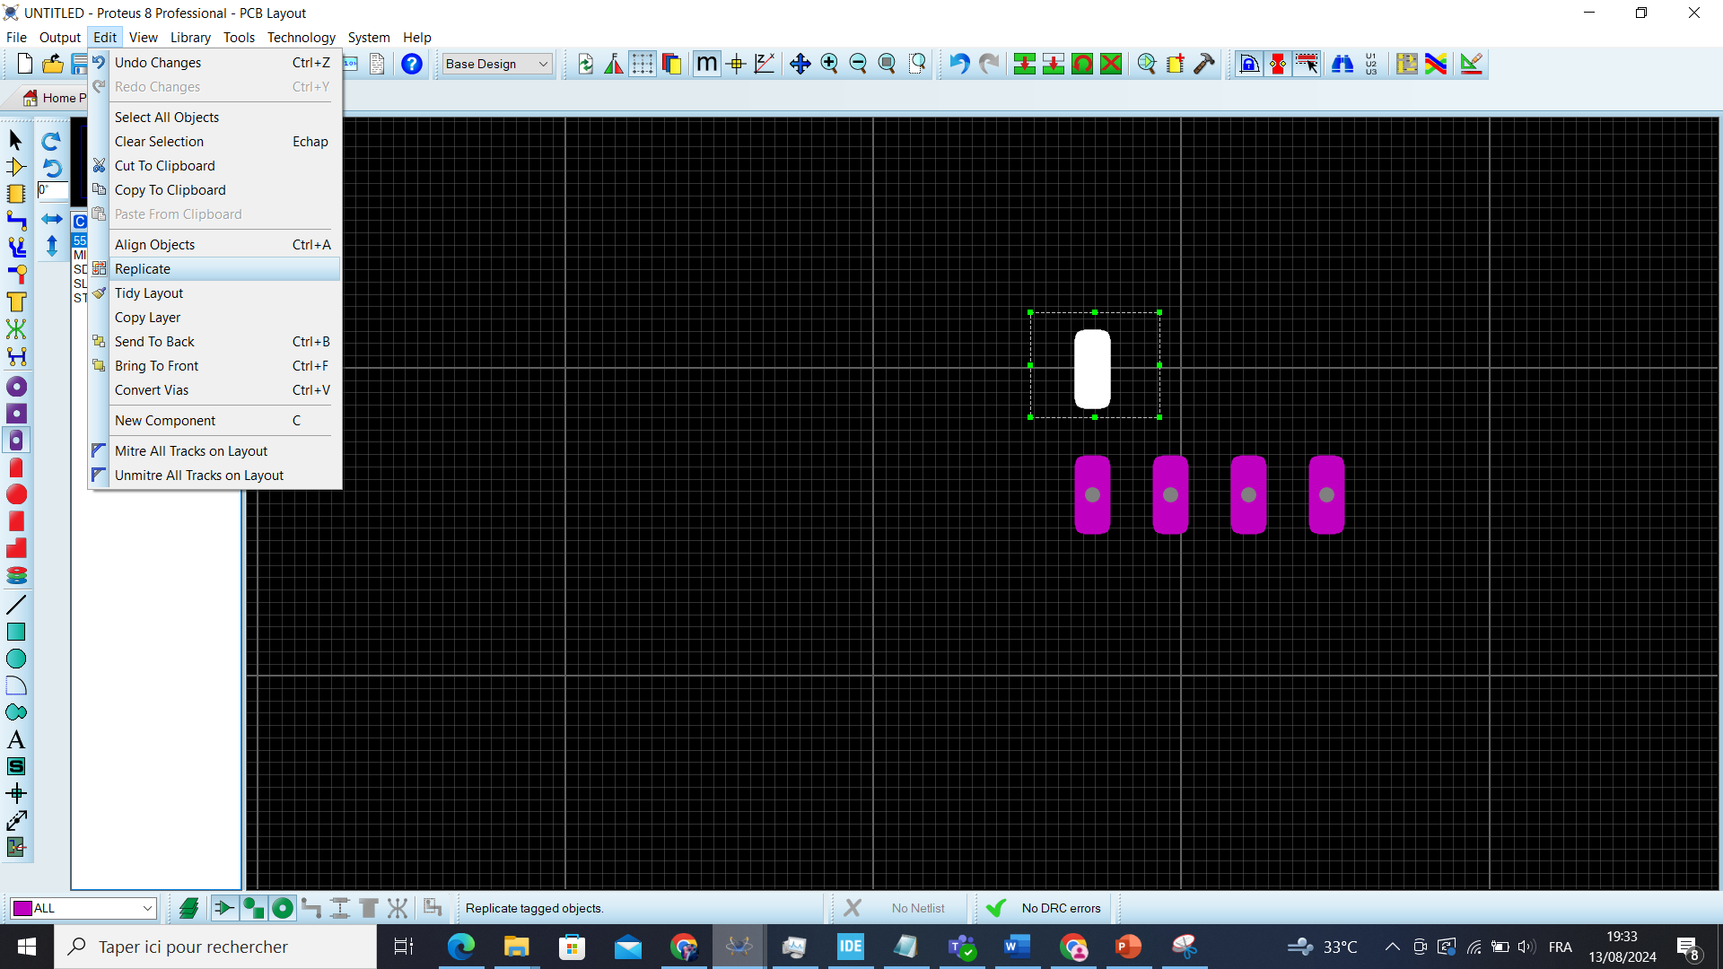

Slide 15
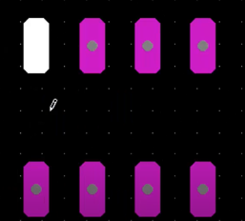

Slide 16
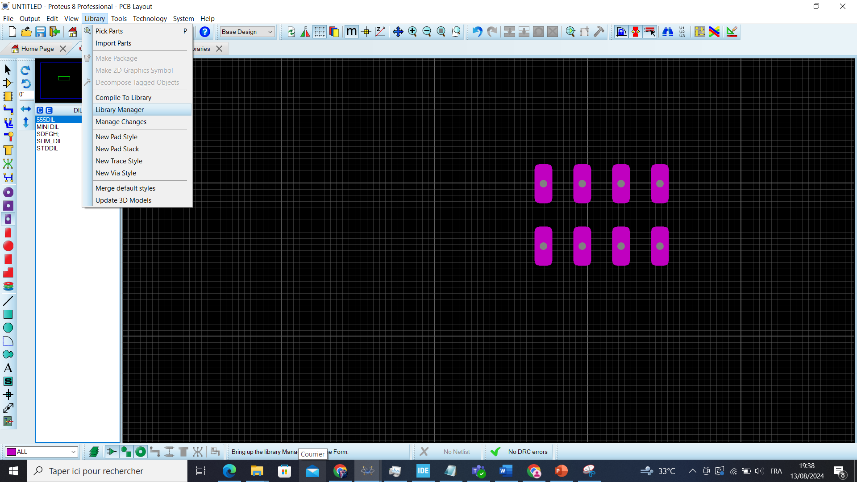

Slide 17
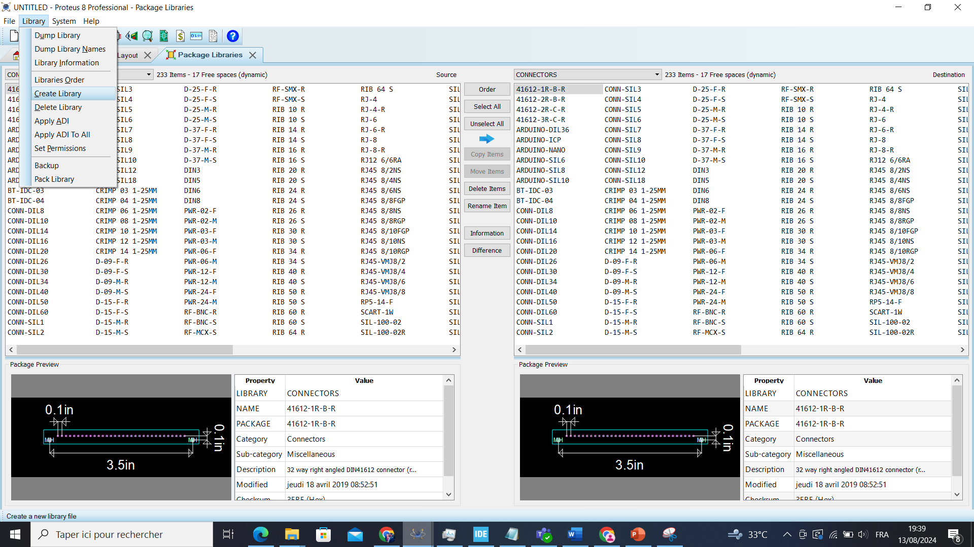

Slide 18
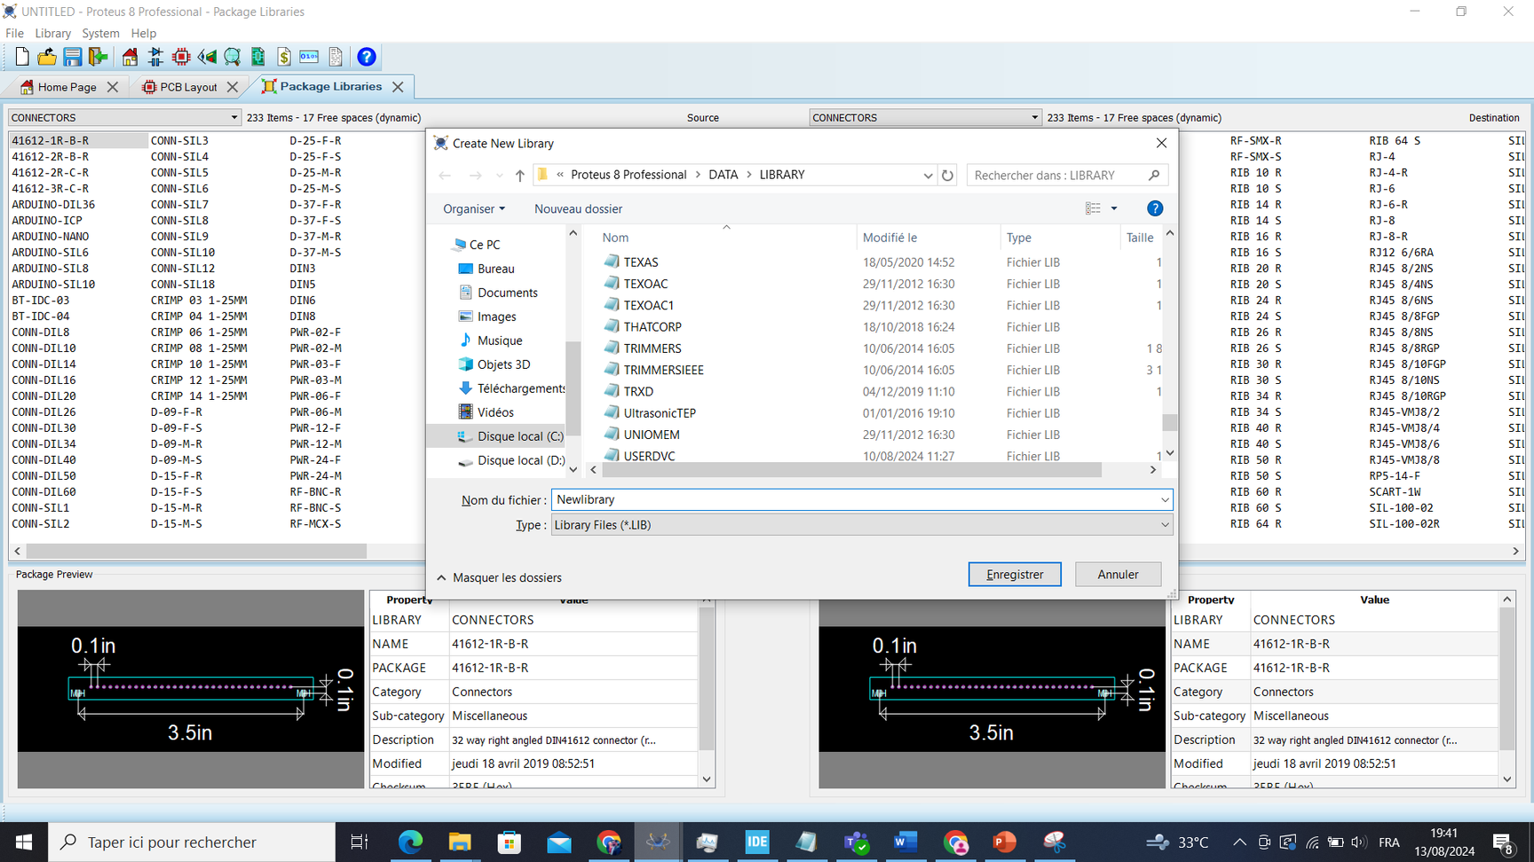
NB : After this step you should reopen your project

Slide 19
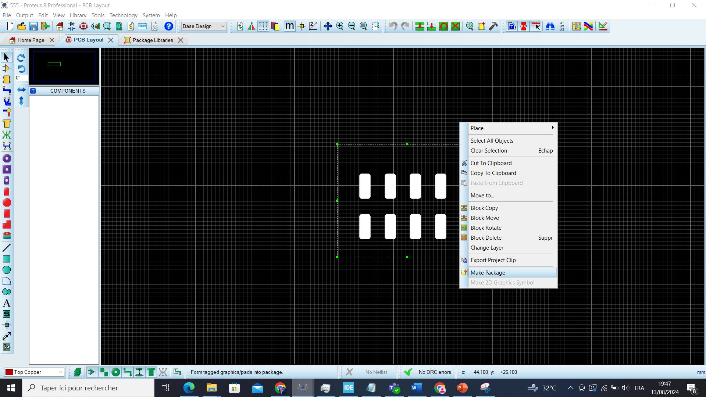

Slide 20
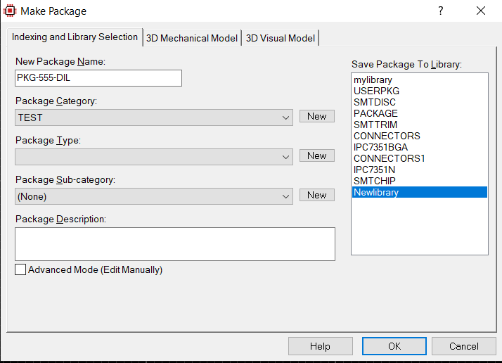

Slide 21
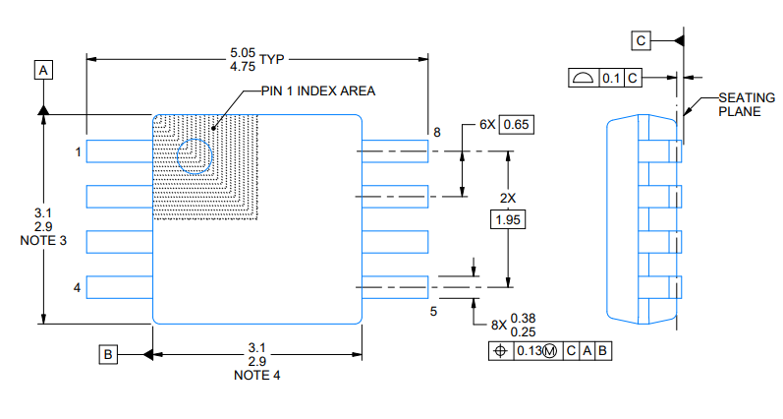
EXAMPLE OF A TIMER 555 CREATION
Then in the second step we will create the SMD package . To create it we have to follow the next steps

Slide 22
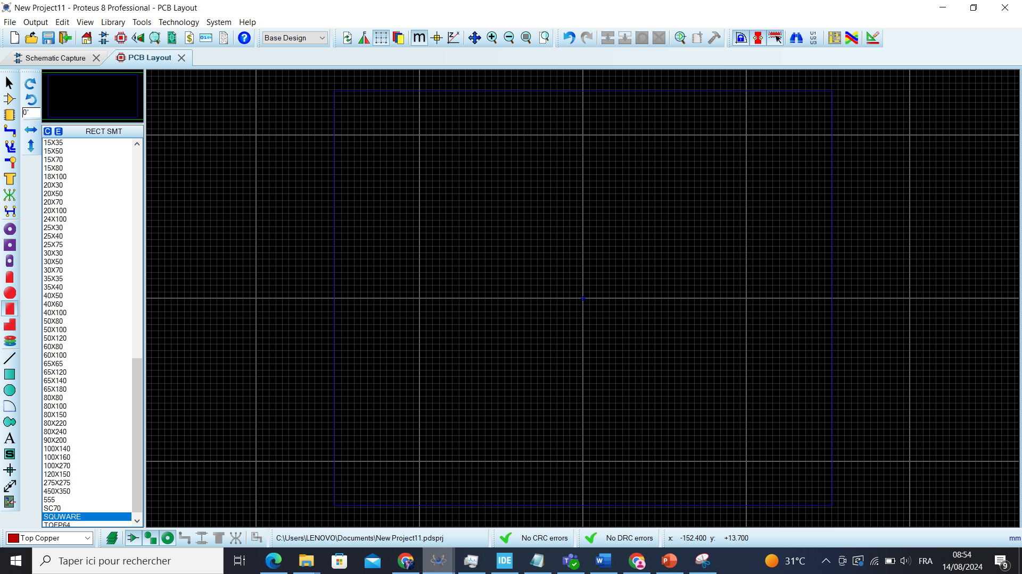

Slide 23
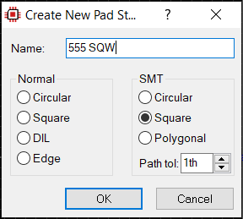
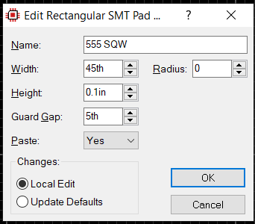
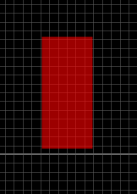

Slide 24
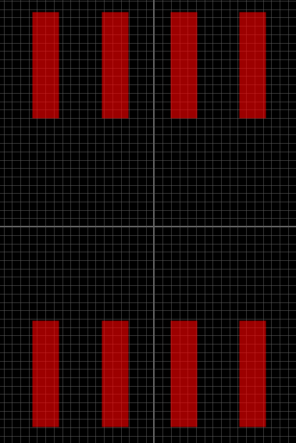
Then we duplicate it to have this result:

Slide 25
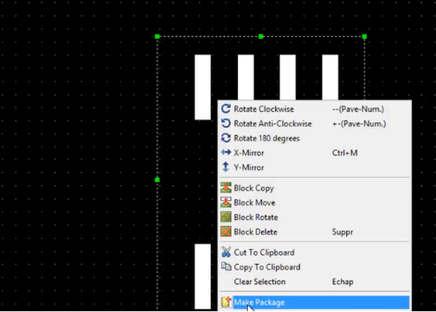
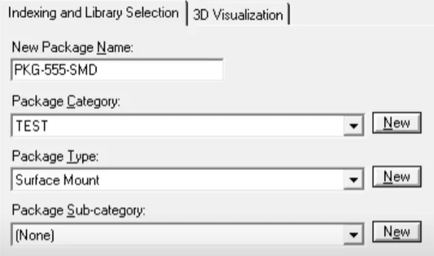

Slide 26
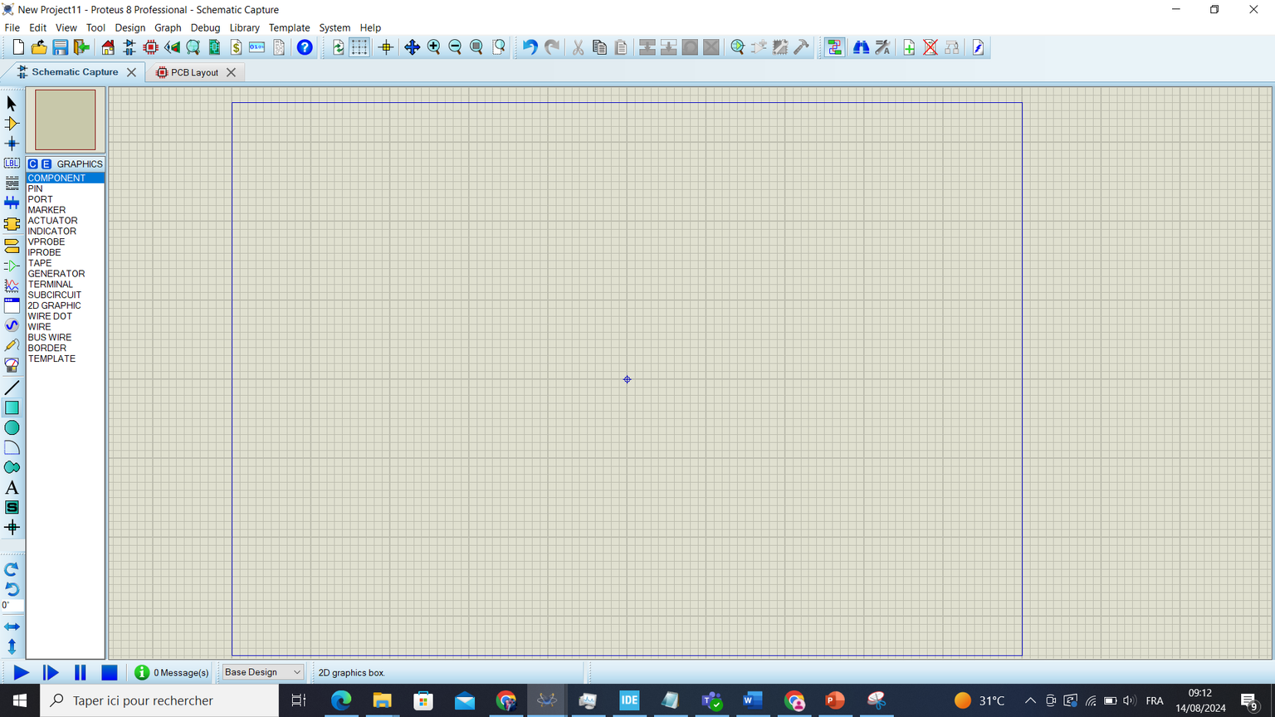
EXAMPLE OF A TIMER 555 CREATION
In the next step we will create the device symbol

Slide 27
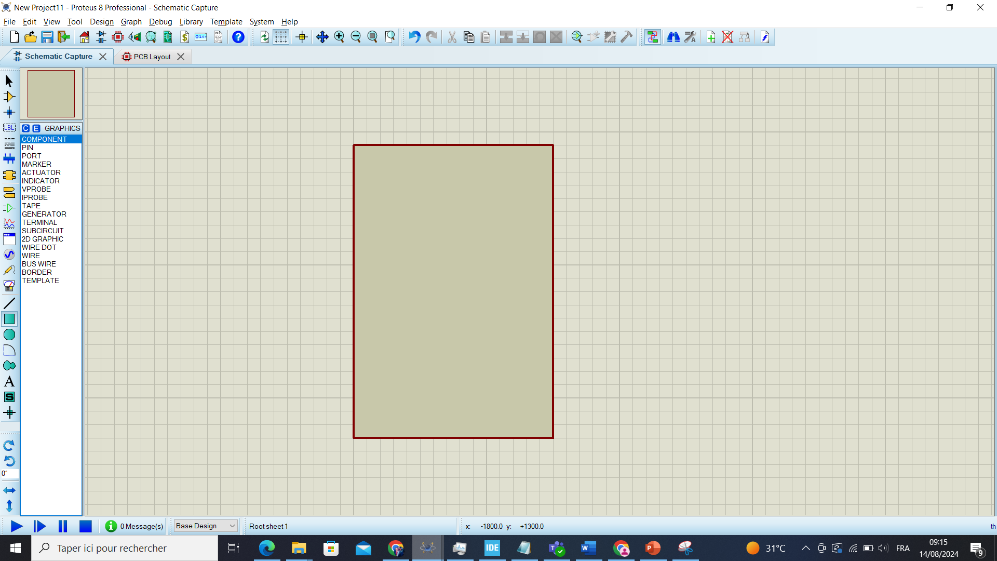

Slide 28
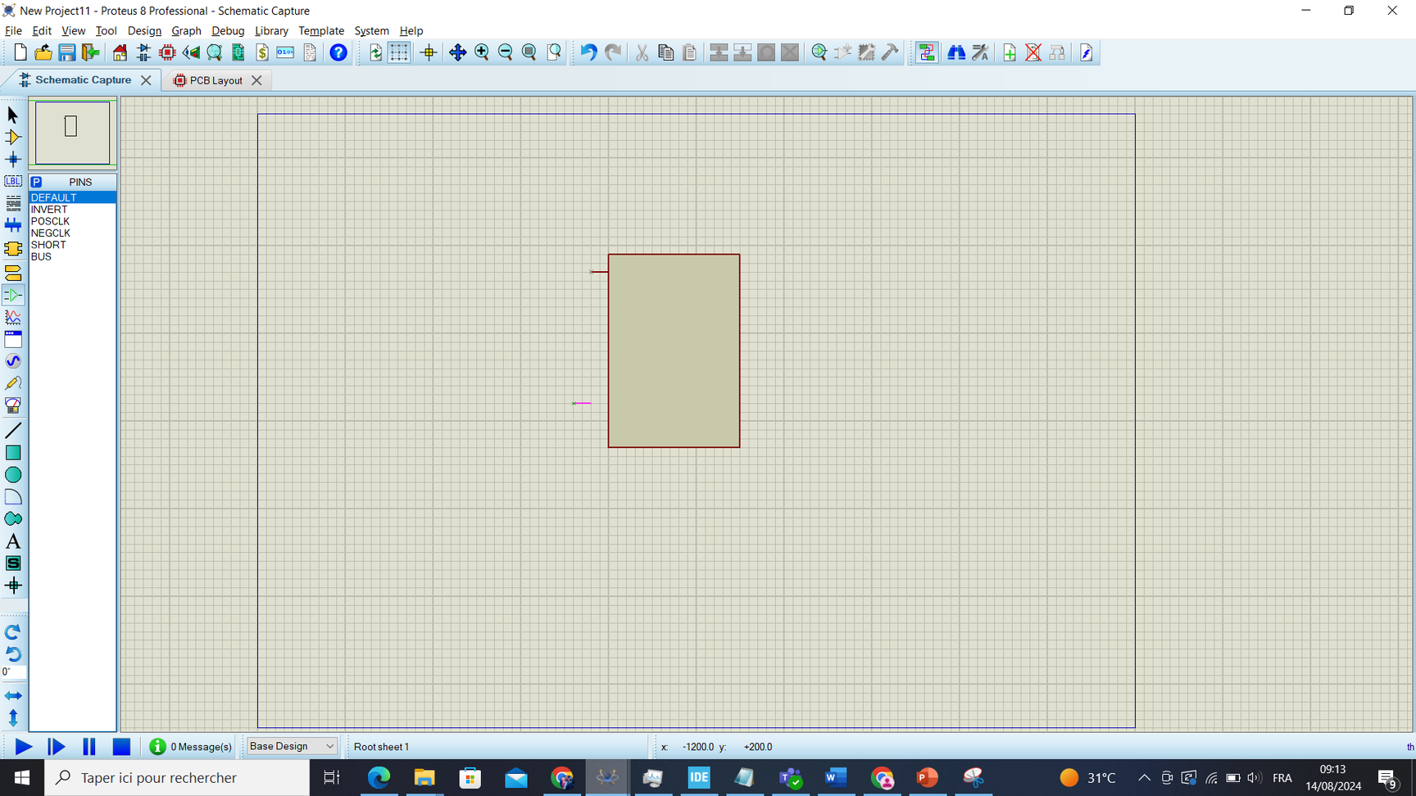

Slide 29
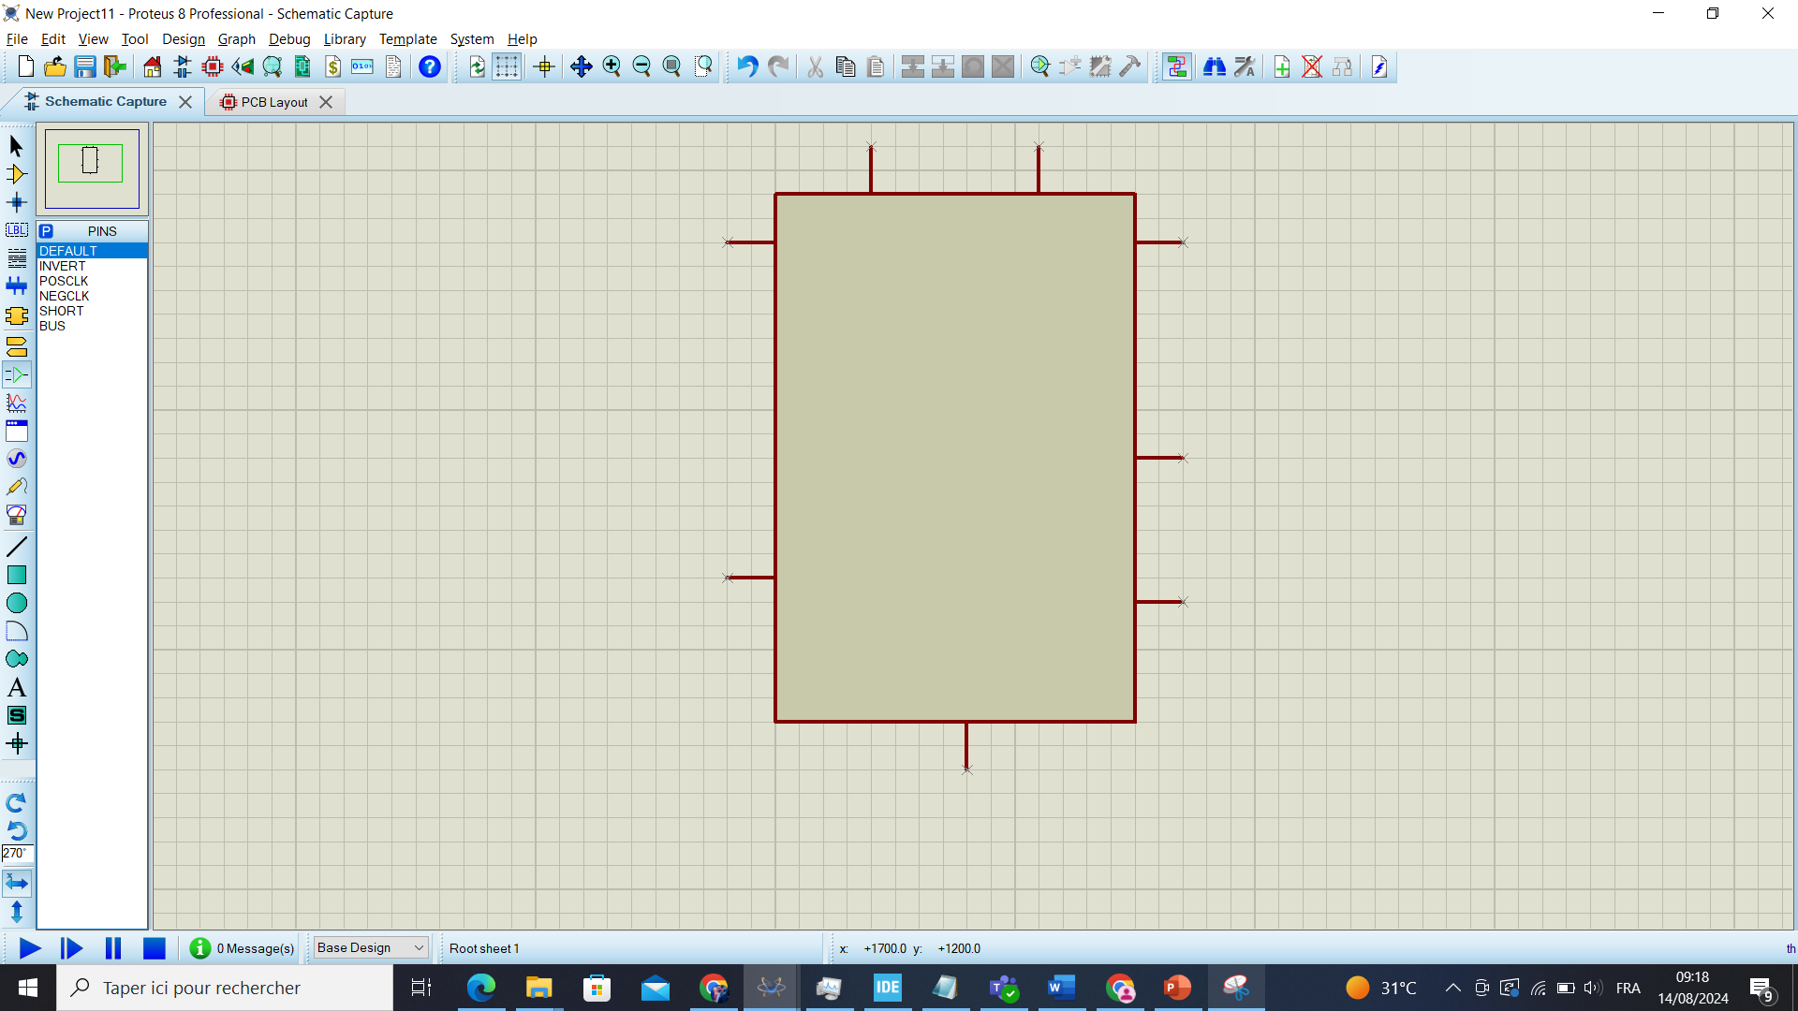

Slide 30
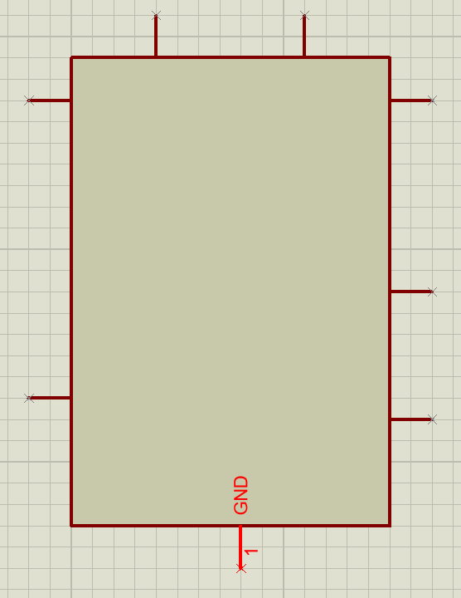
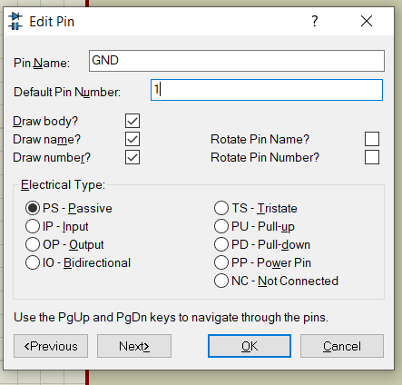

Slide 31
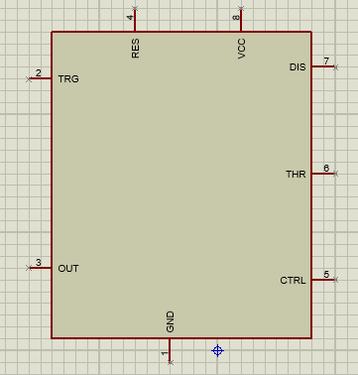

Slide 32
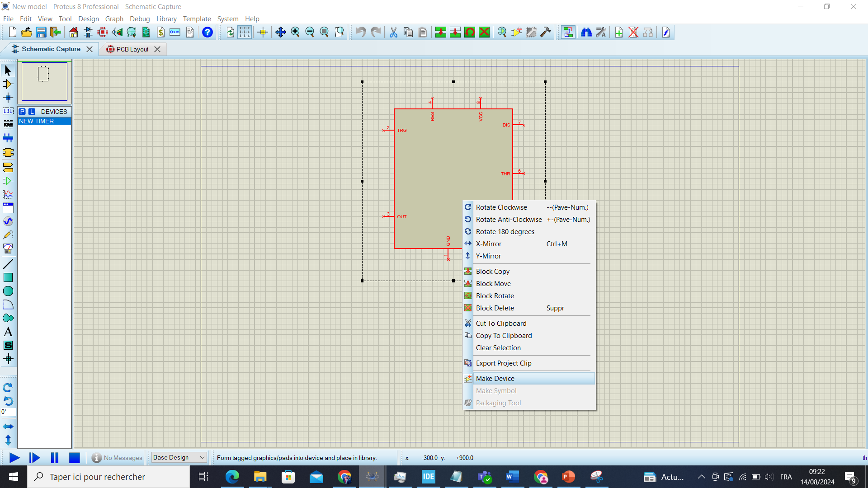

Slide 33
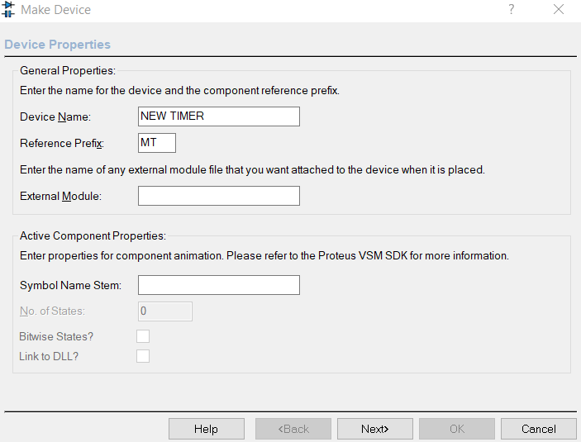
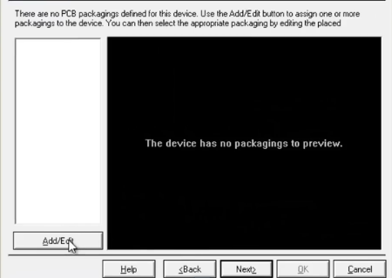

Slide 34
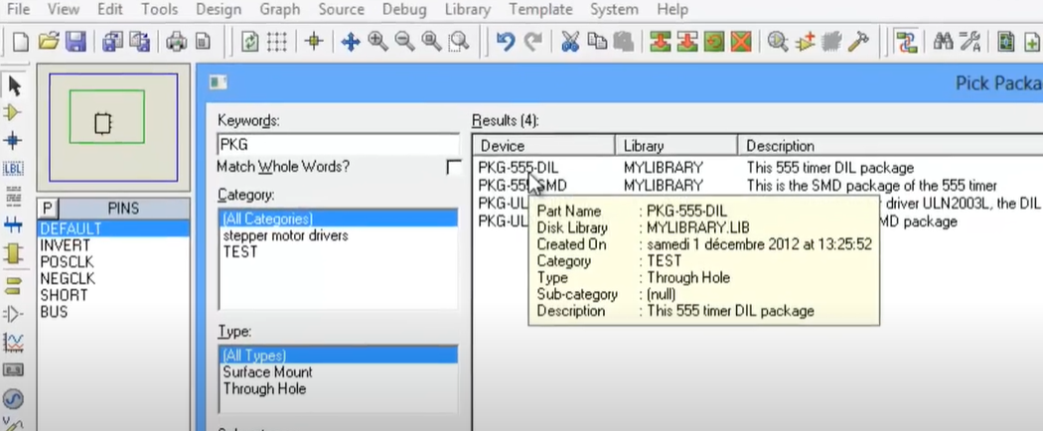
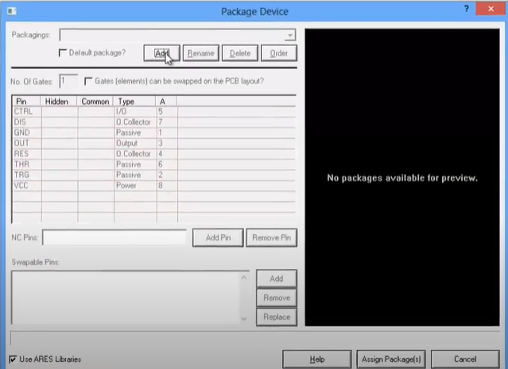
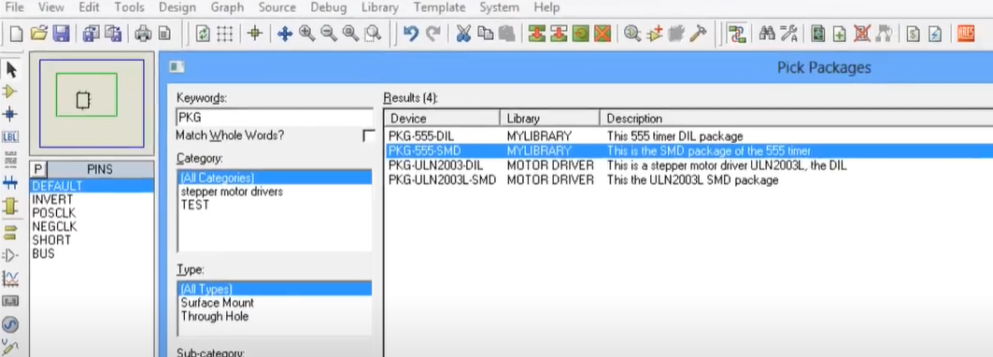


Slide 35
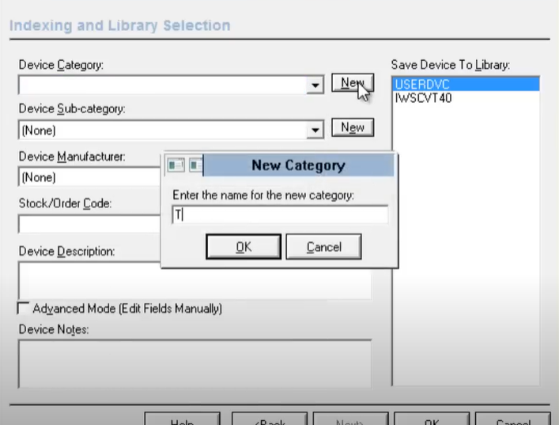

Slide 36
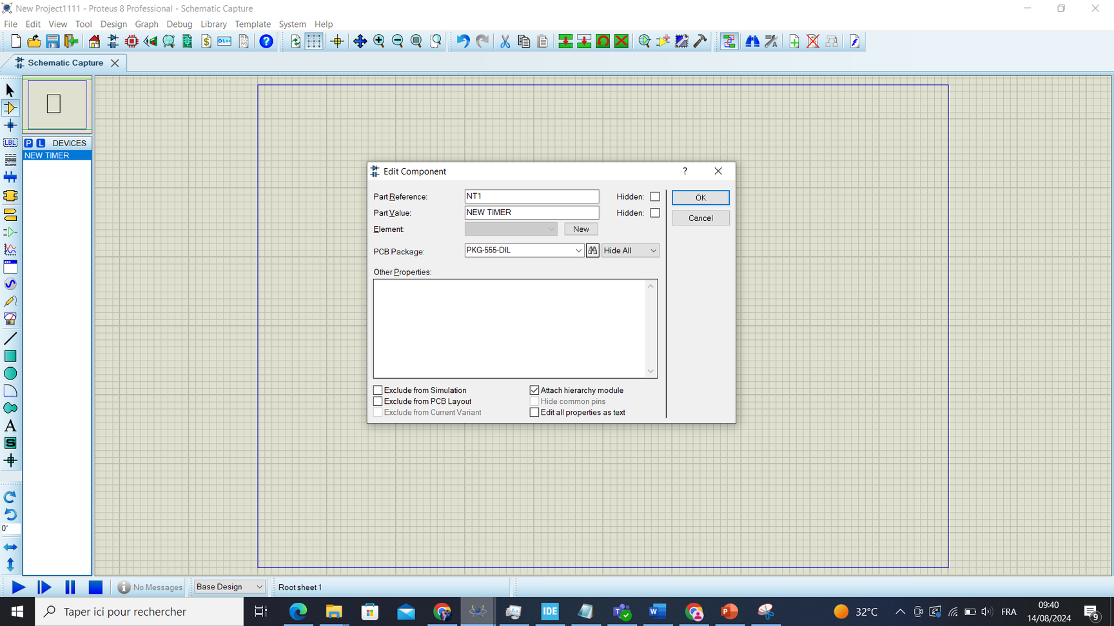
In the final step we will add the internal circuit design of the model

Slide 37
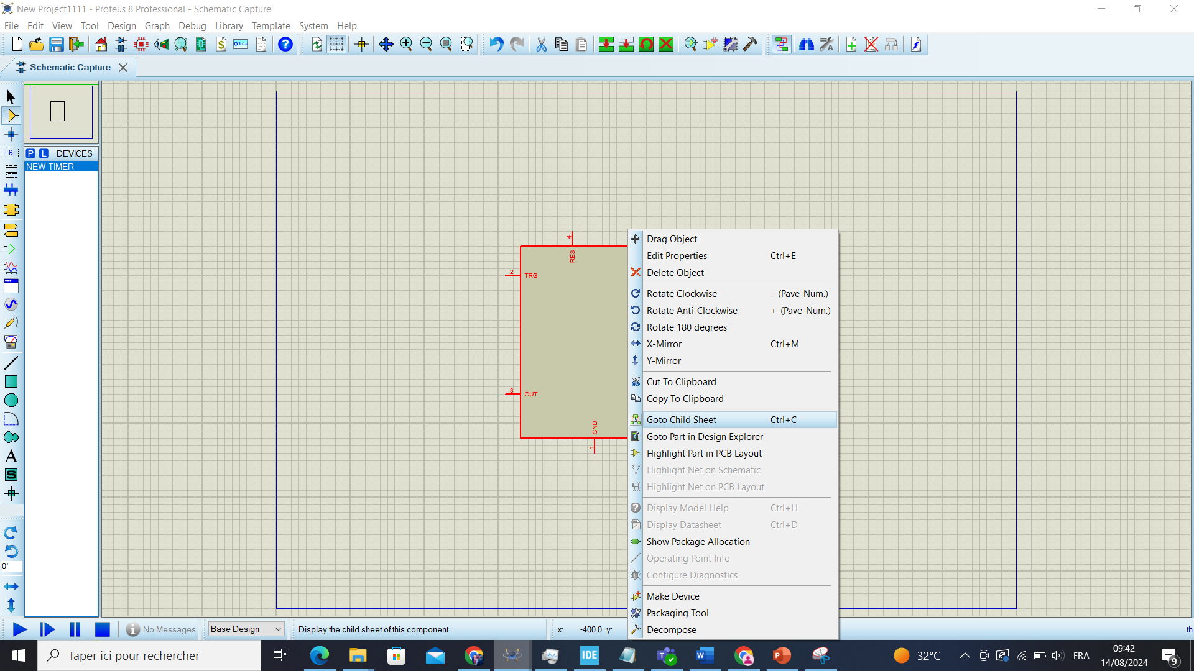

Slide 38
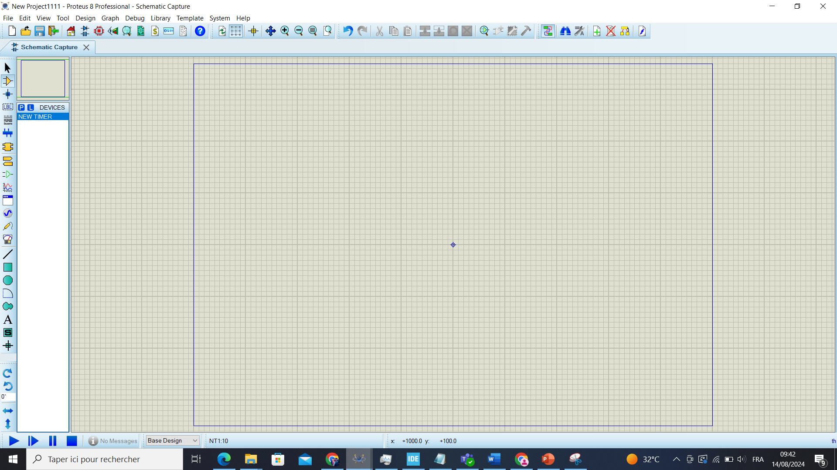

Slide 39


Slide 40
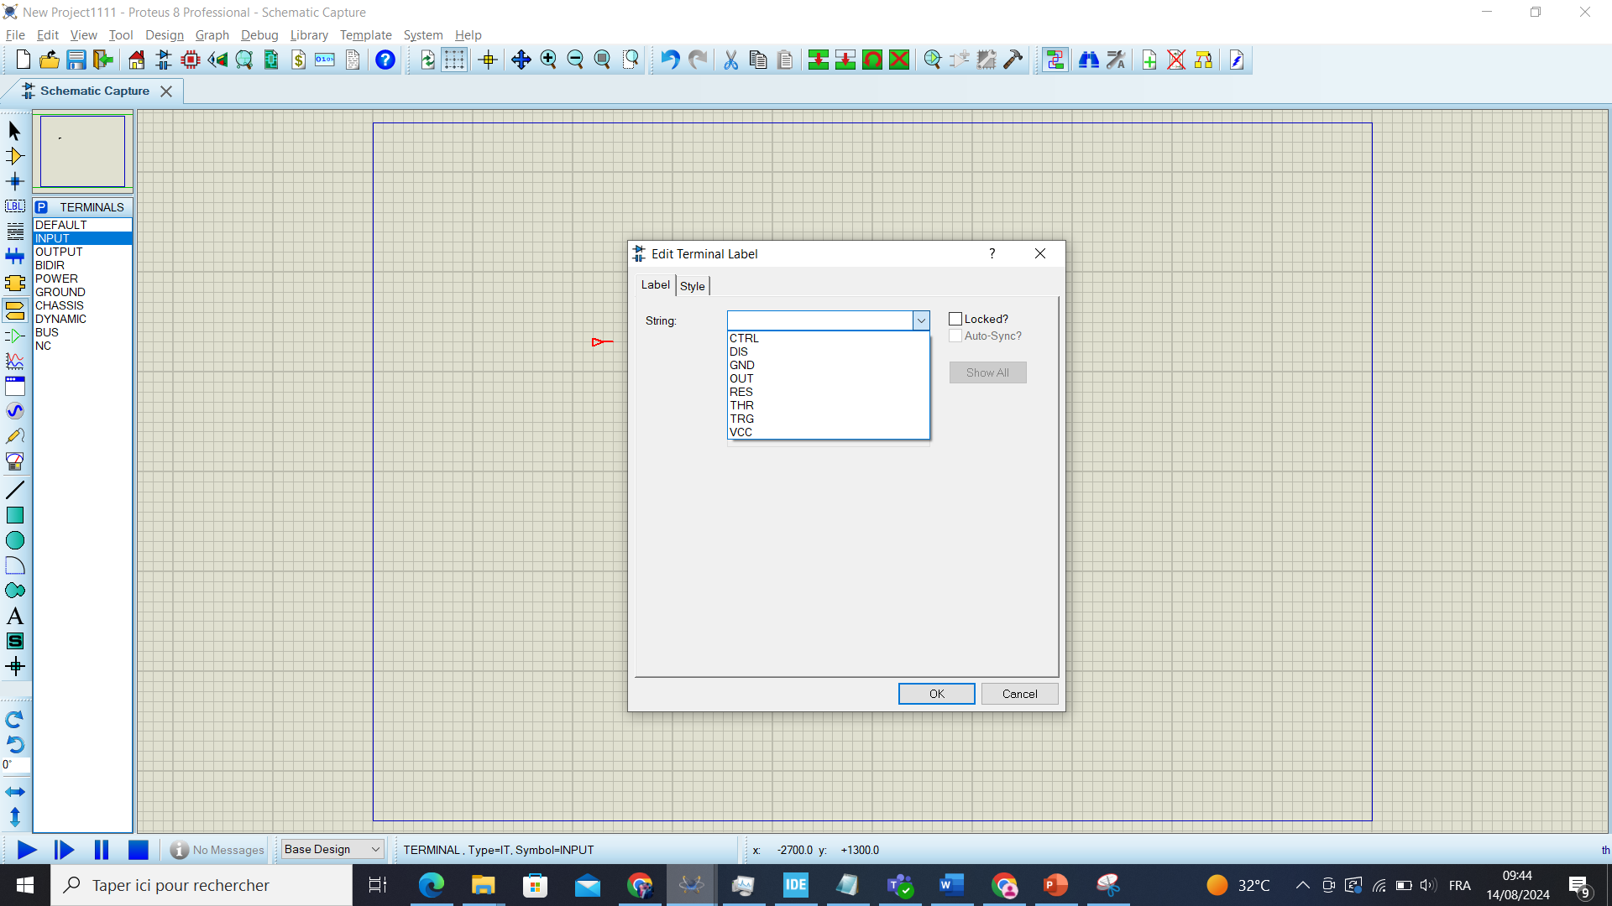
then add all the inputs and the outputs with the same way

Slide 41
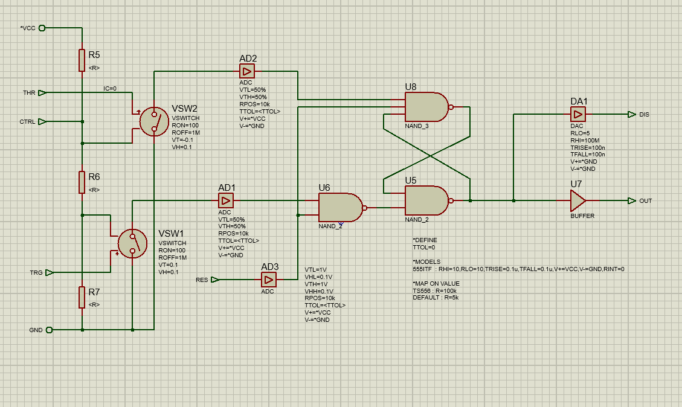

Slide 42
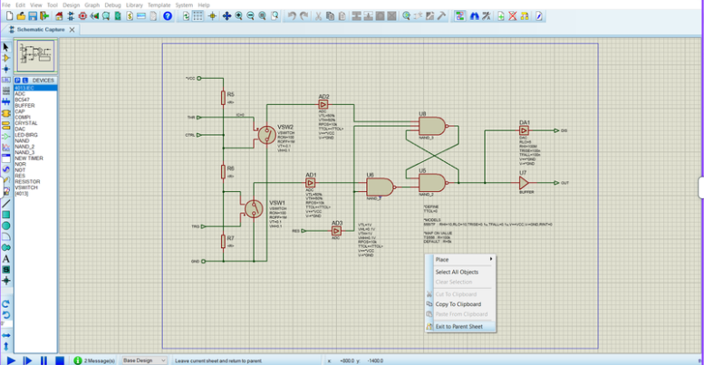

Slide 43
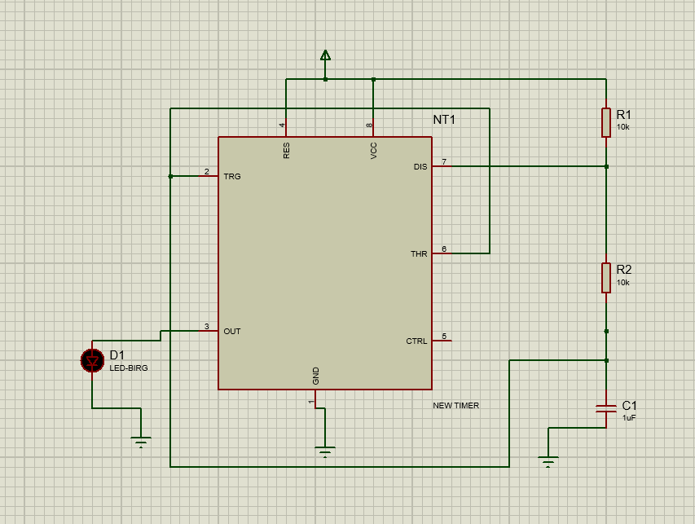
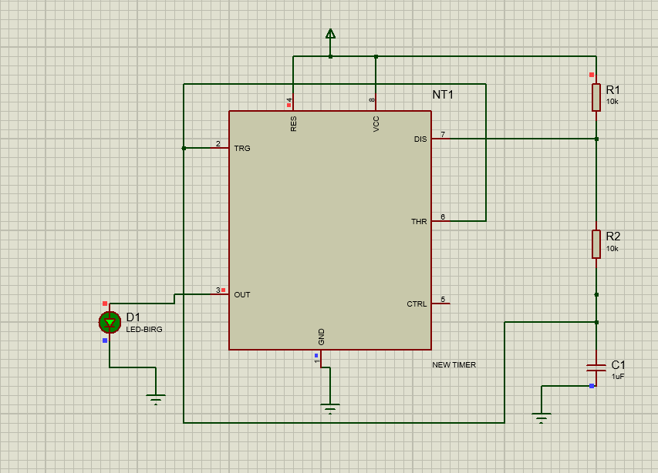

Slide 44
CREATE A DEVICE USING the VSM library
(C++ project)

Slide 45

The principle of this method is to replace the internal architecture with a DLL file. To do this, you need to create a C++ (DLL) project in Visual Studio.

Slide 46
ADD VSM.HPP LIBRARY
Creates and manages virtual simulation models.
Allows running and analyzing simulations in a digital environment.
Includes APIs for model setup and interaction.
here is the link of the vsm file to download : https://github.com/mavrus95/VSMMODS/blob/master/VSM.LIBS/DIGITAL_POTS_DLL/DP_POT/VSM.HPP
in the next step we will take the example of the RS flip-flop creation

Slide 47

ACTIVATE THE NECESSARY FUNCTIONS
We can activate the necessary functions via two files: `active_model.h` and `active_model.c`. The first file (`active_model.h`) declares the functions attracted from vsm.hpp library (i activemodel classe) , while the second file (`active_model.c`) defines them.

Slide 48
ACTIVATE THE NECESSARY FUNCTIONS
1. VOID initialize (ICOMPONENT *cpt):
- Initializes the component specified by `cpt`.
2. ISPICEMODEL *getspicemodel (CHAR *primitive):
- Retrieves the SPICE model (simulation program with integrated circuit emphasis) for the given primitive.
3. IDSIMMODEL *getdsimmodel (CHAR *primitive):
- Retrieves the dynamic simulation model for the given primitive.
4. VOID plot (ACTIVESTATE state):
- Plots data based on the provided active state.
5. VOID animate (INT element, ACTIVEDATA *newstate):
- Animates the element using the new state data.
6. BOOL actuate (WORD key, INT x, INT y, DWORD flags):
- Processes user input based on the key, coordinates, and flags.

Slide 49


ACTIVATE THE NECESSARY FUNCTIONS

Slide 50

VSMMODEL
This file is responsible of simulating the model

Slide 51

MODEL SPECIFICATIONS
The previous files are common to most projects; the differences come in the `dsimmodel` file. In the `dsimmodel.h` file, we declare the specific pins of our model, while in `dsimmodel.cpp`, we specify the algorithm for how the inputs and outputs work, using functions attracted from vsm.hpp library (idsimmodel classe) translating the component’s working algorithm into C++ code.

Slide 52
MODEL SPECIFICATIONS
1. INT isdigital (CHAR *pinname):
- Checks if the pin specified by `pinname` is digital.
2. VOID setup (IINSTANCE *inst, IDSIMCKT *dsim):
- Configures the instance `inst` with the simulation circuit `dsim`.
3. VOID runctrl (RUNMODES mode):
- Controls the execution mode of the simulation based on `mode`.
4. VOID actuate (REALTIME time, ACTIVESTATE newstate):
- Updates or triggers actions in real-time based on `newstate`.
5. BOOL indicate (REALTIME time, ACTIVEDATA *data):
- Provides feedback or status update at `time` using `data`.
6. VOID simulate (ABSTIME time, DSIMMODES mode):
- Runs a simulation at `time` with the specified `mode`.
7. VOID callback (ABSTIME time, EVENTID eventid):
- Handles events at `time` identified by `eventid`.

Slide 53



Slide 54



Slide 55

The building of this code (X86) will generate this file in the debug file

Slide 56

then we have to move it to the proteus libraryies :

Slide 57


Slide 58


Slide 59


Slide 60


Slide 61

After that we have to create the component symbol in proteus

Slide 62

to add the dll library to the component we have to follow these steps:

Slide 63


Slide 64


Slide 65


Slide 66


Slide 67


Slide 68


